Slide 1
WHAT MOTIVATES ADULTS TO LEARN ?
ADITI CHOUDHARY

Slide 2
Terminologies
Pedagogy - 7th -12th C - the art and science of teaching children
Andragogy –1960S – art/Science of helping adults learn
Two ends of a spectrum ?

Slide 3
WHY ANDRAGOGY ?
Time span of cultural changes lesser than life span
Knowledge became obsolete within a matter of years
Important to learn how to learn – how to learn the skills of self directed inquiry
ASSUMPTIONS ABOUT THE CHARACTERISTICS OF LEARNERS CHALLENGED

Slide 4
Pedagogy v andragogy
Concept of learner – dependent v. self directed
Role of learner’s experience – ltd value v. rich resource
Readiness to learn – have to v. need to learn (u bantu)
Orientation to learn – subject matter context v. performance centered (apply now)

Slide 5
Malcolm S. Knowles
CHARACTERISTICS OF ADULT LEARNERS/6 ADULT LEARNING PRINCIPLES
Adults are autonomous and self-directed
Adults have accumulated a foundation of life experiences and knowledge
Adults are goal-oriented – clearly defined elements
Adults are relevancy-oriented – why am I doing this ?
Adults are practical
adults need to be shown respect

Slide 6
https://www.youtube.com/watch?v=vLJ7cRwKI-I
https://www.youtube.com/watch?v=vLoPiHUZbEw

Slide 7
Adults are autonomous and self-directed
What do they want to learn - Ask them what they want to have by way of sessions - topics and methodolOgy
Get papers/articles – contribute to reading material/ presentations
Duration
Evaluation
Ask problems faced by them / group discussion/panel of resource person
First theory then practice

Slide 8
Adults have accumulated a foundation of life experiences and knowledge
Flagging of issues before planning schedule
Maximum interactive programmes – role plays – hypotheticals
Sharing of best practices – individual or group effort - court m’ment case m’ment judicial skills – what have u done and what will you do – way forward
Brief resource person assesses the level of knowledge and experience of the participants so that he takes it from there forward >>>
because they like to solve problems with their past experience
learn about their work experince and encourage their problem solving

Slide 9
Goal oriented +relevancy oriented + practical
Tell them why are they being asked to attend a programme – objectives of the programme needs to be set out when planning
More of practical sessions than theoretical – theories of punishment is important but it has to be combined with dos and don’ts of sentencing -JUDGMENT WRITING
Proper nominations

Slide 10
adults need to be shown respect
selection of resource persons
briefing of resource person – show respect -allow for differences
Effective moderating – laying down the rules of the game (permission to leave – interjections etc.)
Motivation - Physical environment & psychological environment - Adults are self conscious – take them from comfort to learning zone avoid pushing them into the panic zone eg. 20 oldest cases.

Slide 11
WHAT MotivateS the Adult Learner ?

Slide 12
WHAT MotivateS the Adult Learner ?
Social relationships – need for associations/friendships
External expectations – fulfill expectations/recommendations from formal authority
Social welfare – serve mankind/community service
Personal advancement – professional advancement
Escape/Stimulation – break from routine
Cognitive interest/problem solving

Slide 13
Success + volition + value (relevance) + enjoyment - Willingness to learn and being successful in the learning activity – you have to make them willing and successful learners –eg. computer training
Establishing inclusion
Developing attitude – creating a favourable disposition towards learning experience through personal relevance & volition
Enhancing meaning – creating challenging & engaging learning experiences That include learners perspective & values
Engendering competence – creating an understanding that learners are effective in learning something they value

Slide 14
What are the Barriers to Motivation ?

Slide 15
HOW CAN YOU MotivatE THE ADULT LEARNER ?

Slide 16
Learner Types
Feelers
Observers
Thinker
Doer

Slide 17
https://www.youtube.com/watch?v=oNxCporOofo

Slide 18
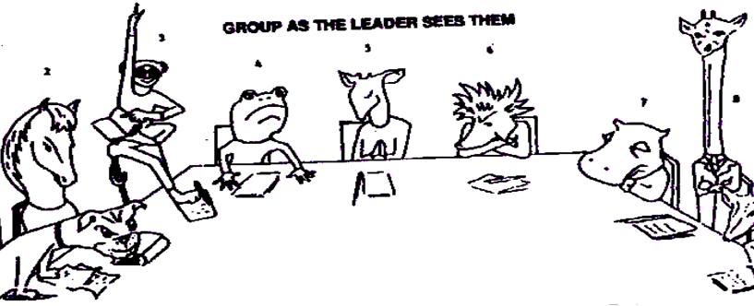
The Uncooperative “Rejecting” Type
The Thick – Skinned Uninterested Type
The Highbrow Type
The Persistent Questioner
The Quarrelsome Type
The Positive Type
The know – All Type
The Loquacious Type
The Shy Type

Slide 19
POWER OF THE SENSES
Smell 3 %
Taste 3 %
Touch 6 %
Hearing 13 %
Sight 75 %

Slide 20
QUIZZ – HANDOUT

Slide 21
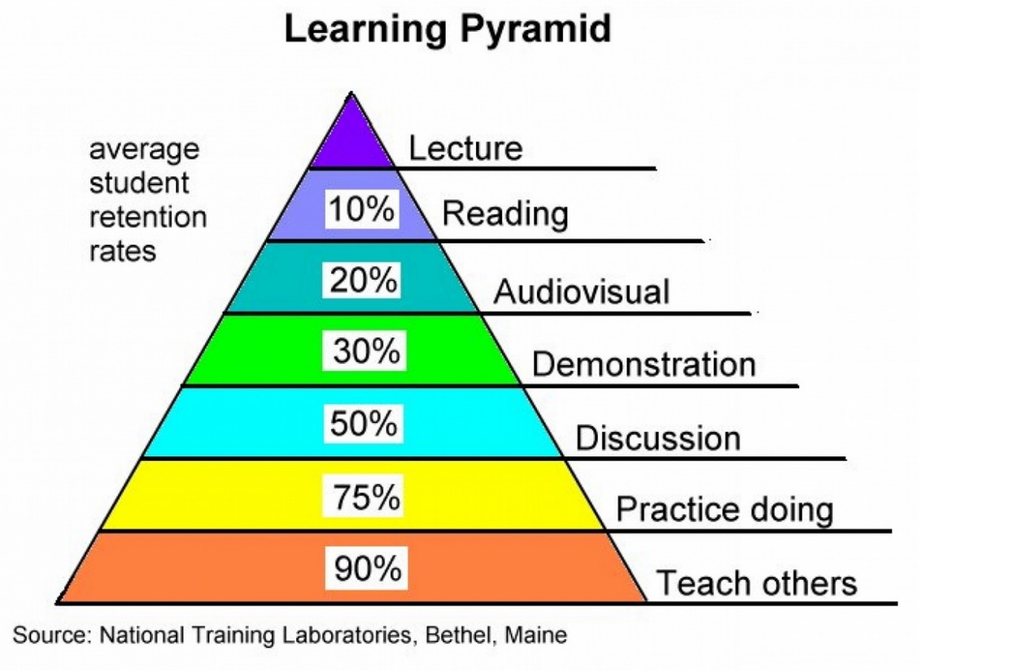

Slide 22
Why ?
Did I tell you that you have something to gain from this session – that it would help you fulfil some need of yours ?
Why did you pay attention to me ?
Did I use more than one methodology to convey what I wanted to ?
Would you remember what we discussed in this session – why ?

Slide 23
I cannot teach anybody anything I can only make them think
- Socrates

